Slide 1

Predictive Modeling and Analysis of Autism Spectrum Disorder Using Machine Learning Techniques
Autism spectrum disorder (ASD) is a complex neurological condition that affects how individuals communicate, interact, and behave. Leveraging machine learning can provide valuable insights to better understand and support individuals with ASD.
by 1005 AARON JOEL, 1009 ABESHEK SRIKANTH

Slide 2
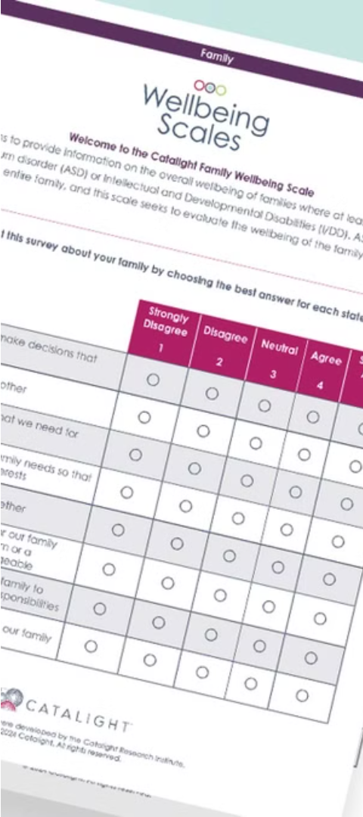
Problem Statement
1
Early Detection
2
Personalized Interventions
Develop accurate predictive models to facilitate early identification of ASD, enabling timely intervention and support.
Analyze patterns in ASD-related data to recommend personalized treatment and educational strategies.
3
Improving Outcomes
Leverage machine learning to uncover insights that can lead to improved quality of life for individuals with ASD.

Slide 3
Existing System
Current Practices
Limitations
Opportunities
Diagnosis of ASD typically relies on clinical assessments and behavioral observations, which can be subjective and time-consuming.
Existing systems often struggle to capture the complexity and heterogeneity of ASD, leading to challenges in personalized interventions.
Machine learning can enhance the accuracy and efficiency of ASD diagnosis and management, tailoring solutions to individual needs.

Slide 4
Proposed System
Data Loading and Preprocessing
1
Load the dataset and display basic information.
2
Exploratory Data Analysis
Handle missing values and replace specific values for consistency.
Visualize the distribution and value counts of key features.
Generate count plots, distribution plots, and box plots for different types of features.
Data Balancing
3
Address class imbalance using RandomOverSampler to ensure a balanced distribution of the target variable.
4
Feature Selection and Engineering
Remove irrelevant features and create a feature set for model training.
Model Training and Evaluation
5
Split the dataset into training and validation sets.
Generate correlation matrix to understand feature relationships.
Standardize the features using StandardScaler.

Slide 5
Package Used
Imblearn
Scikit-learn
Imbalanced-learn (imblearn) is a Python library for handling imbalanced datasets.
A versatile machine learning library in Python, offering a wide range of algorithms.
Xgboost
Seaborn
XGBoost is an optimized gradient boosting library designed for high performance and speed.
Seaborn is a Python visualization library based on matplotlib, providing high-level interfaces for creating attractive and informative statistical graphics

Slide 6
Predictive Modeling Algorithms
Algorithms Used:
Logistic Regression
XGBoost Classifier
Support Vector Classifier (SVC)

Slide 7
Why Logistic Regression ?
Logistic Regression is used in this code as one of the classification algorithms for predicting the likelihood of an individual being diagnosed with Autism Spectrum Disorder (ASD). Logistic Regression is a simple yet effective algorithm commonly used for binary classification tasks like this one.
Logistic Regression is specifically designed for binary classification tasks. It models the probability of a binary outcome using the logistic function, which ensures that the predicted probabilities are bounded between 0 and 1, making it suitable for classification tasks like predicting ASD diagnosis.

Slide 8
Why XGBoost ?
XGBoost (Extreme Gradient Boosting) is used in this code for several reasons:
Performance
Accuracy
Handling Non-linearity
Robustness

Slide 9
Why XGBoost ?
XGBoost (Extreme Gradient Boosting) is used in this code for several reasons:
Performance
Accuracy
Handling Non-linearity
Robustness

Slide 10
Why SVC ?
SVC Provides the following reasons in this code:
Effective in High-dimensional Spaces
Margin Maximization
Tunable Parameters

Slide 11
Evaluation Metrics
Metrics used:
ROC AUC Score (for training and validation accuracy)
Confusion Matrix

Slide 12
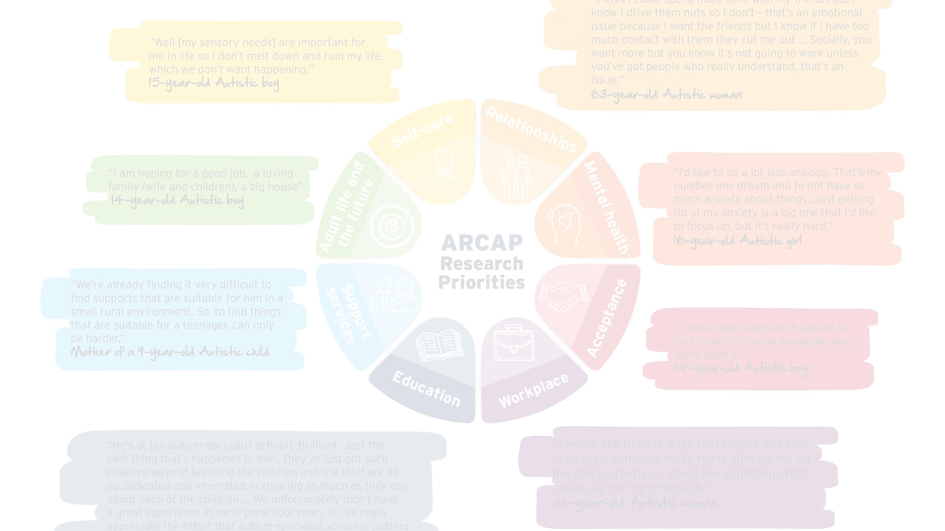



Conclusion
Enhance Diagnosis
Personalize Interventions
Improve Outcomes
Develop accurate predictive models to support early identification of ASD.
Empower healthcare professionals and individuals with ASD to make informed decisions for better quality of life.
Leverage machine learning to uncover insights for personalized treatment and educational strategies.

